Slide 1

scTalk 1: Best practices for single-cell analysis
Arash B. Abadi
Nov 25, 2025

Slide 2

What is single-cell Talk (scTalk)?
Discussion-driven single-cell journal club
Break down key/new papers
Shared standards and critical thinking in analysis
Open questions, interruptions, and debate encouraged

Slide 3
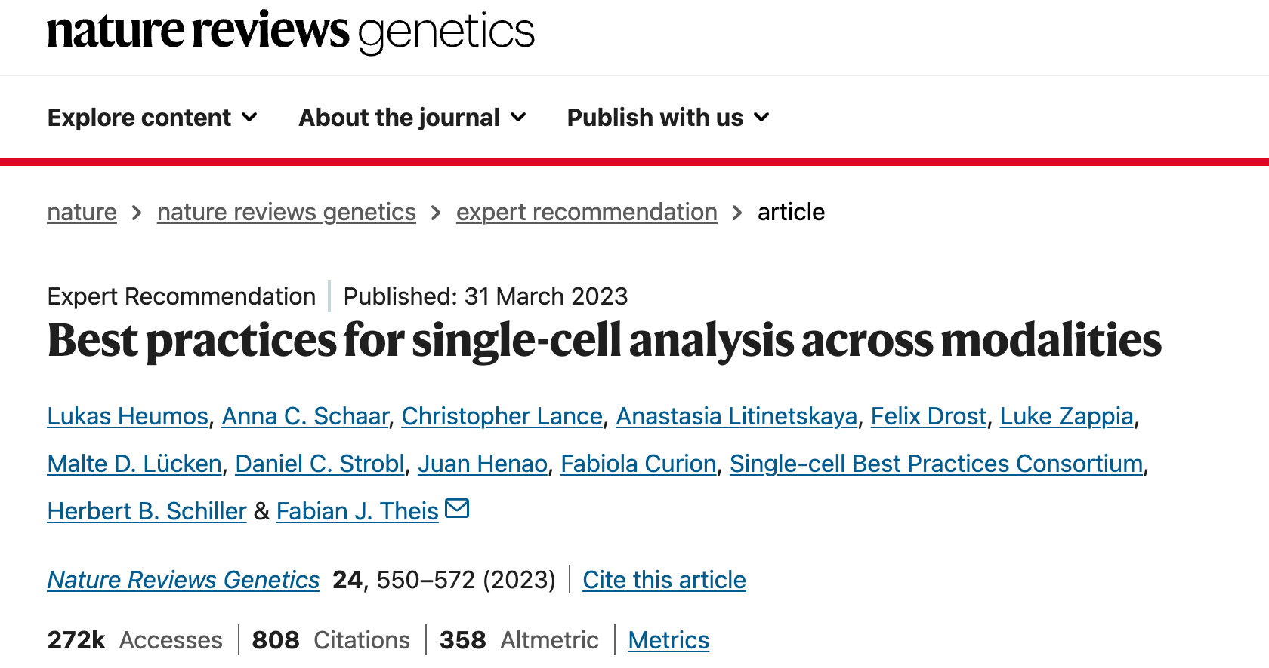
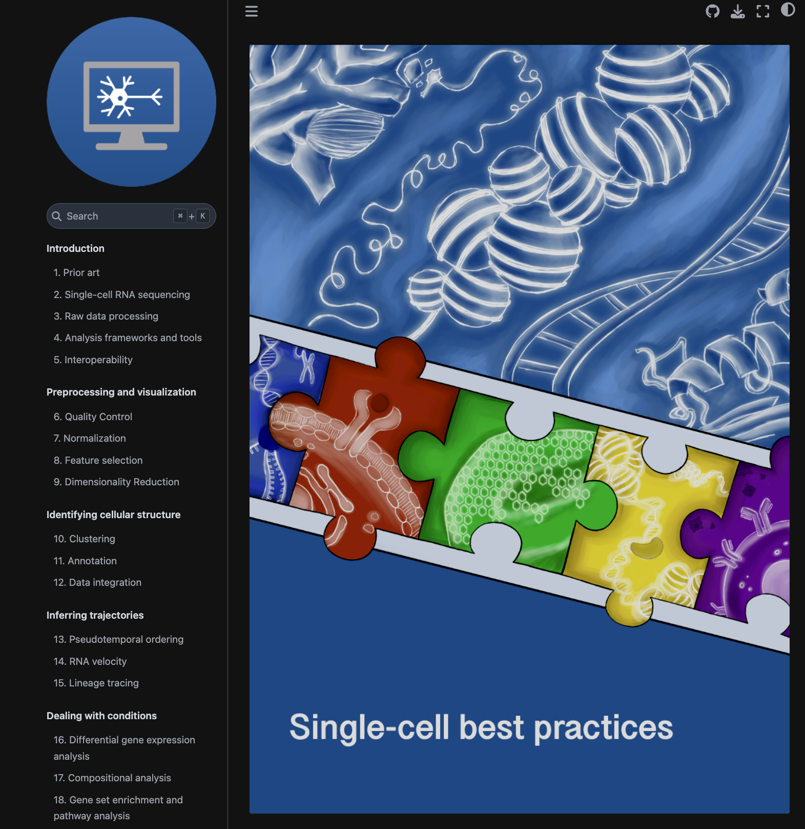
https://www.nature.com/articles/s41576-023-00586-w

Slide 4
Single Cell 101 for Engineers

Slide 5

The Body as a Country!
Body = USA
Organs = States with specialized roles (Brain, Heart, Lungs, etc.)
Tissues = Cities (Cardiac muscle, Alveolar tissue, etc.)
Niche = Neighborhoods
Cells = Buildings / Organizations / Companies

Slide 6
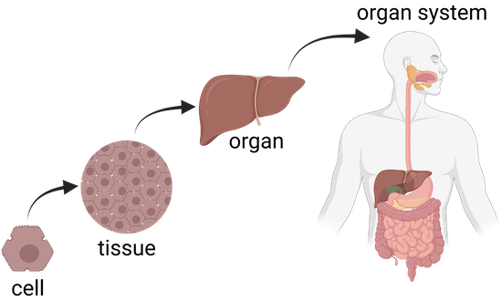
Cells coordinate to keep each “city” functioning!
A cell is the basic membrane-bound unit that contains the fundamental molecules of life and of which all living things are composed.
A single cell is often a complete organism in itself.
https://www.britannica.com/science/cell-biology
https://www.khanacademy.org/

Slide 7
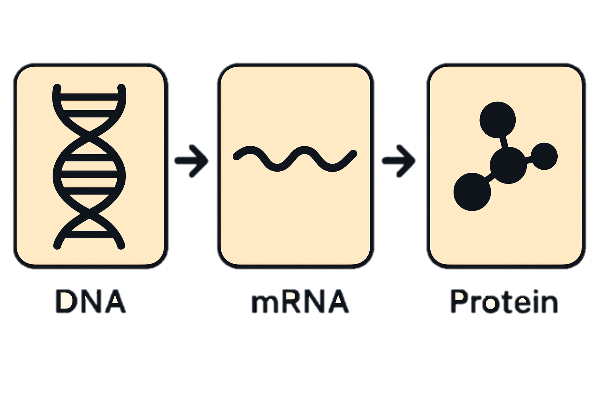

Every cell = a self-run organization inside the city
DNA = full archive of laws and manuals
Genes = individual regulations
mRNA = copied memos for active tasks
Proteins = workers, machines, and tools
Signals = inter-building communication

Slide 8
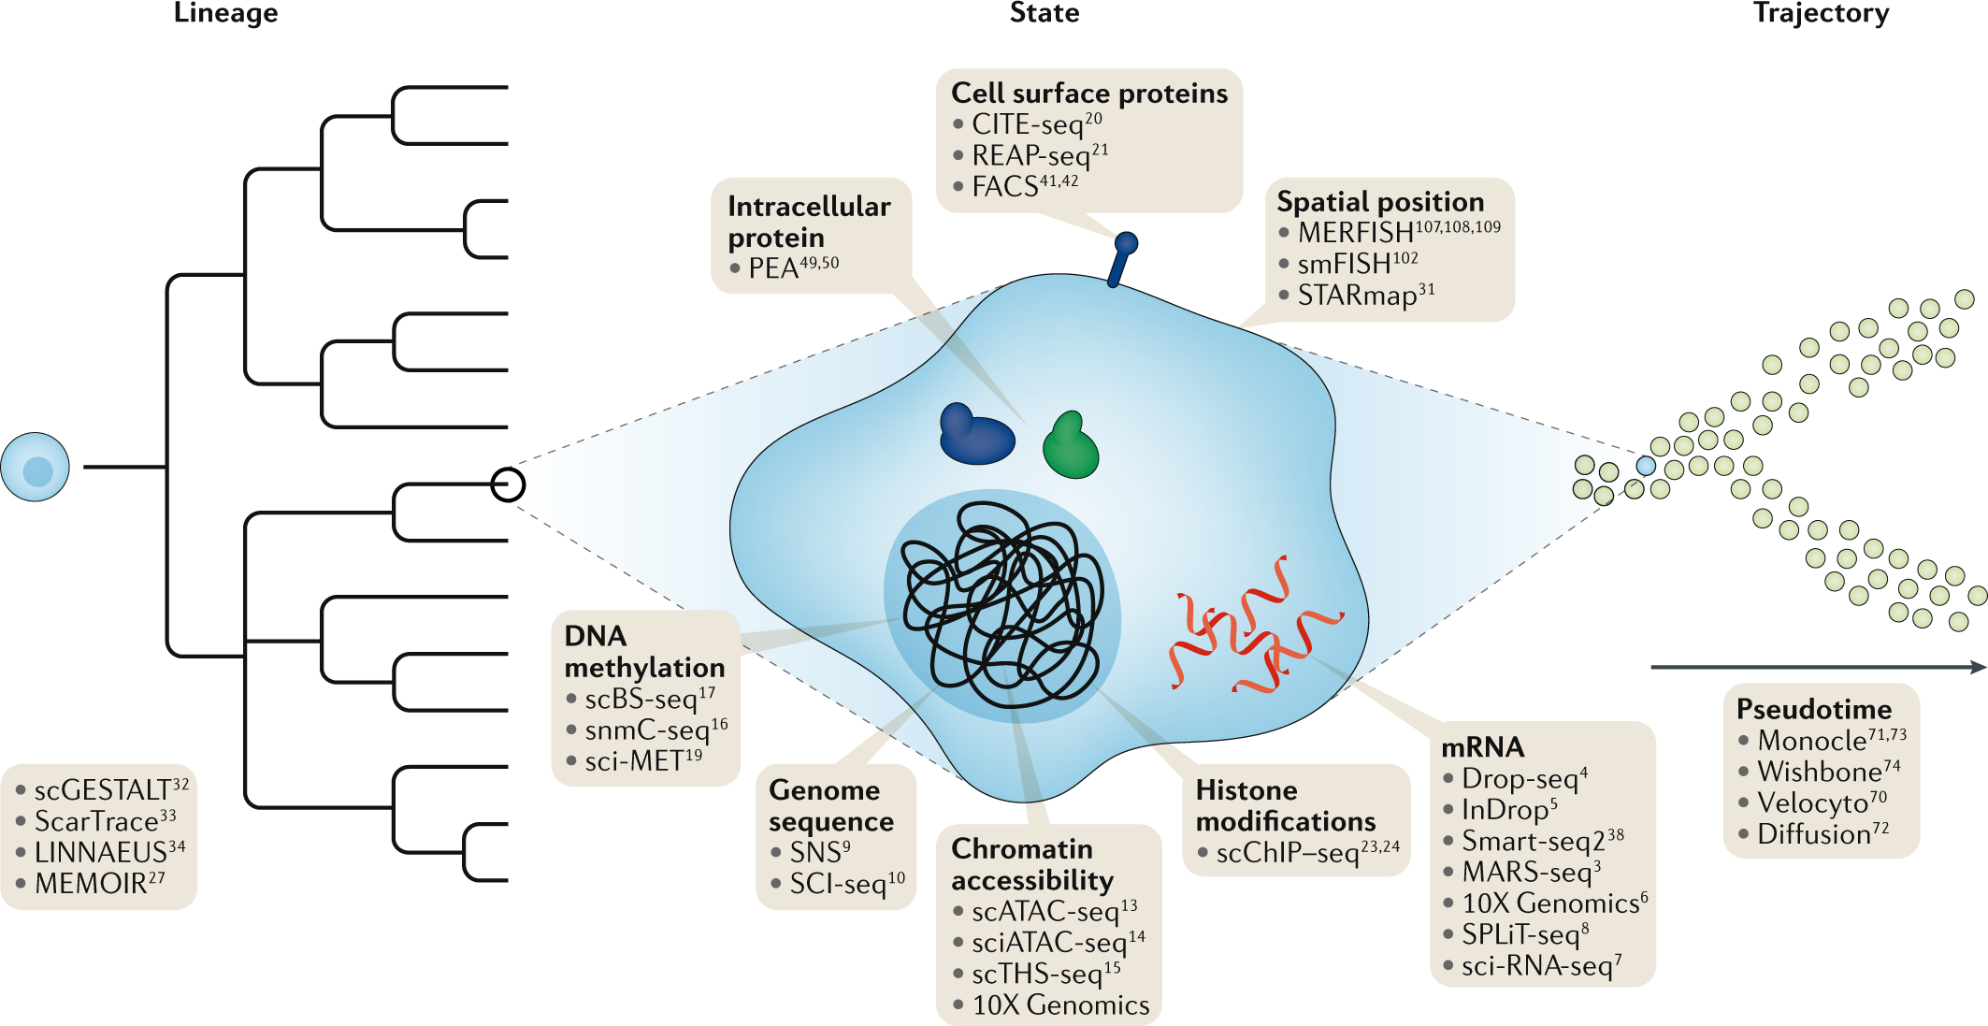
Proteomics = Workers, Machines, and Tools Operating in the Company
Metabolomics = Fuel, Supplies, Raw Materials, Waste
Genomics = The Full Law Book + Master Manuals
Transcriptomics (RNA-seq) = Memos Being Copied & Circulated
Epigenomics = Access Control + Bookmarks + Locked Archives
Stuart and Satija. Nature Reviews Genetics. 20:257-272. May 2019

Slide 9
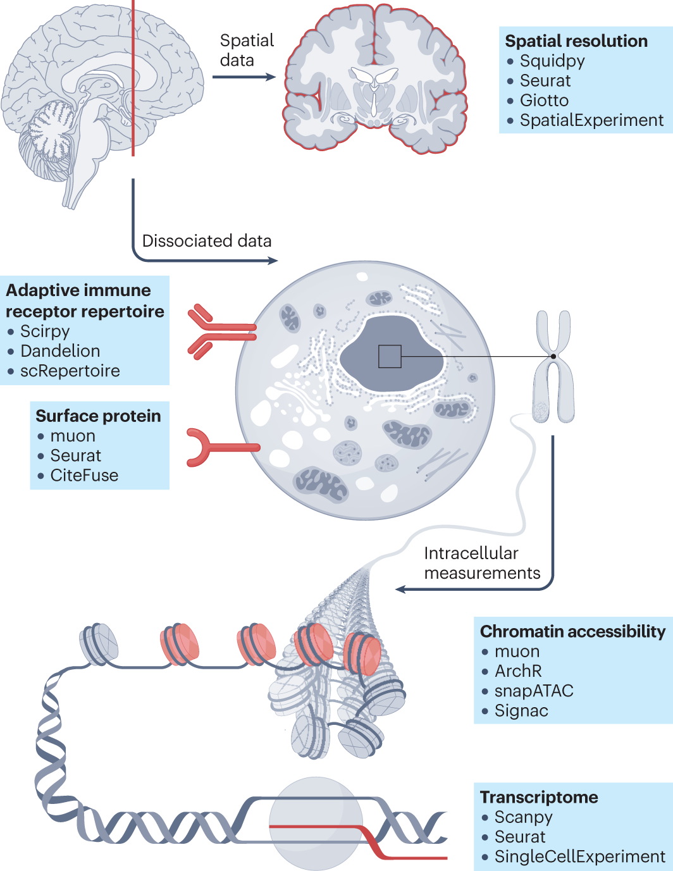





Fig1. Single-cell analysis across modalities
in
in
( )

Slide 10
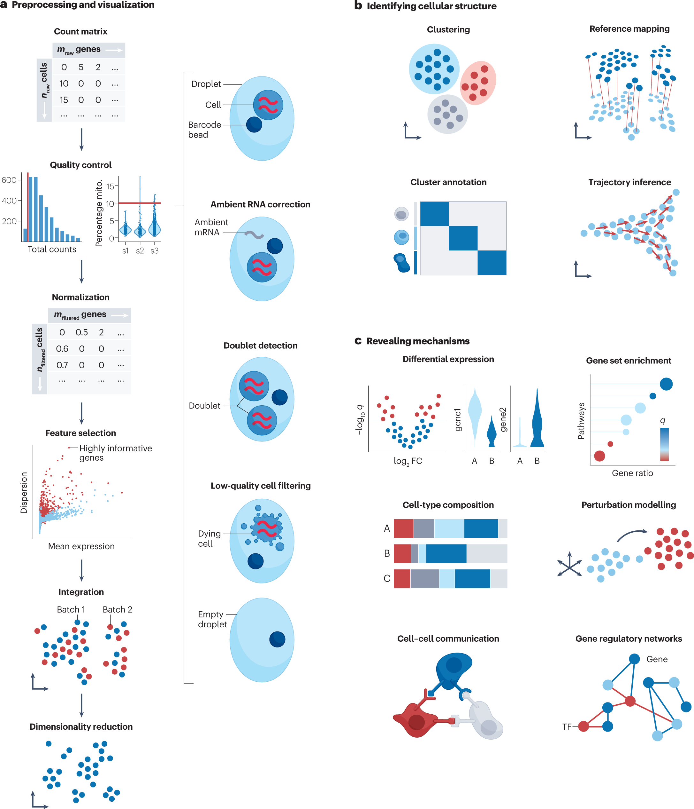
Fig2. Overview of unimodal analysis steps for scRNA-seq

Slide 11
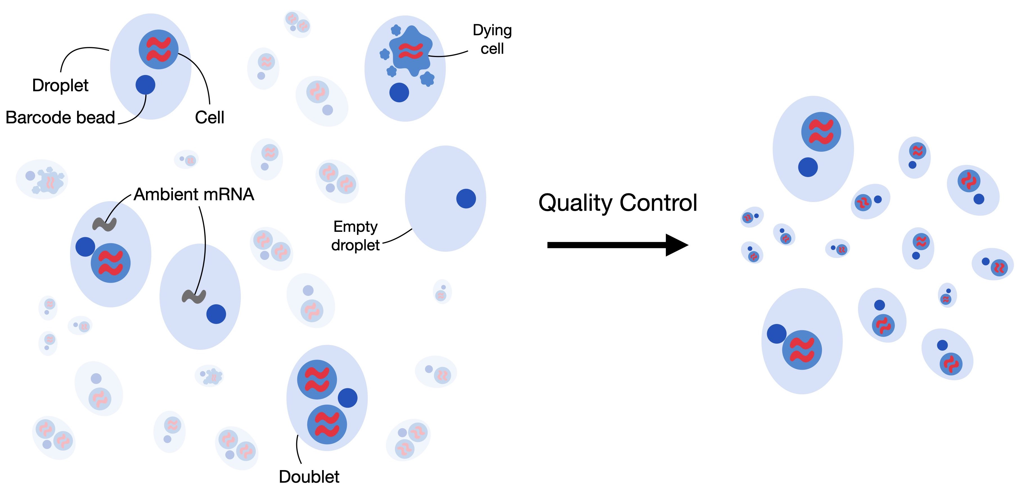
Fig. 6.1 low-quality cells, cell-free RNA and doublets (Book)

Slide 12
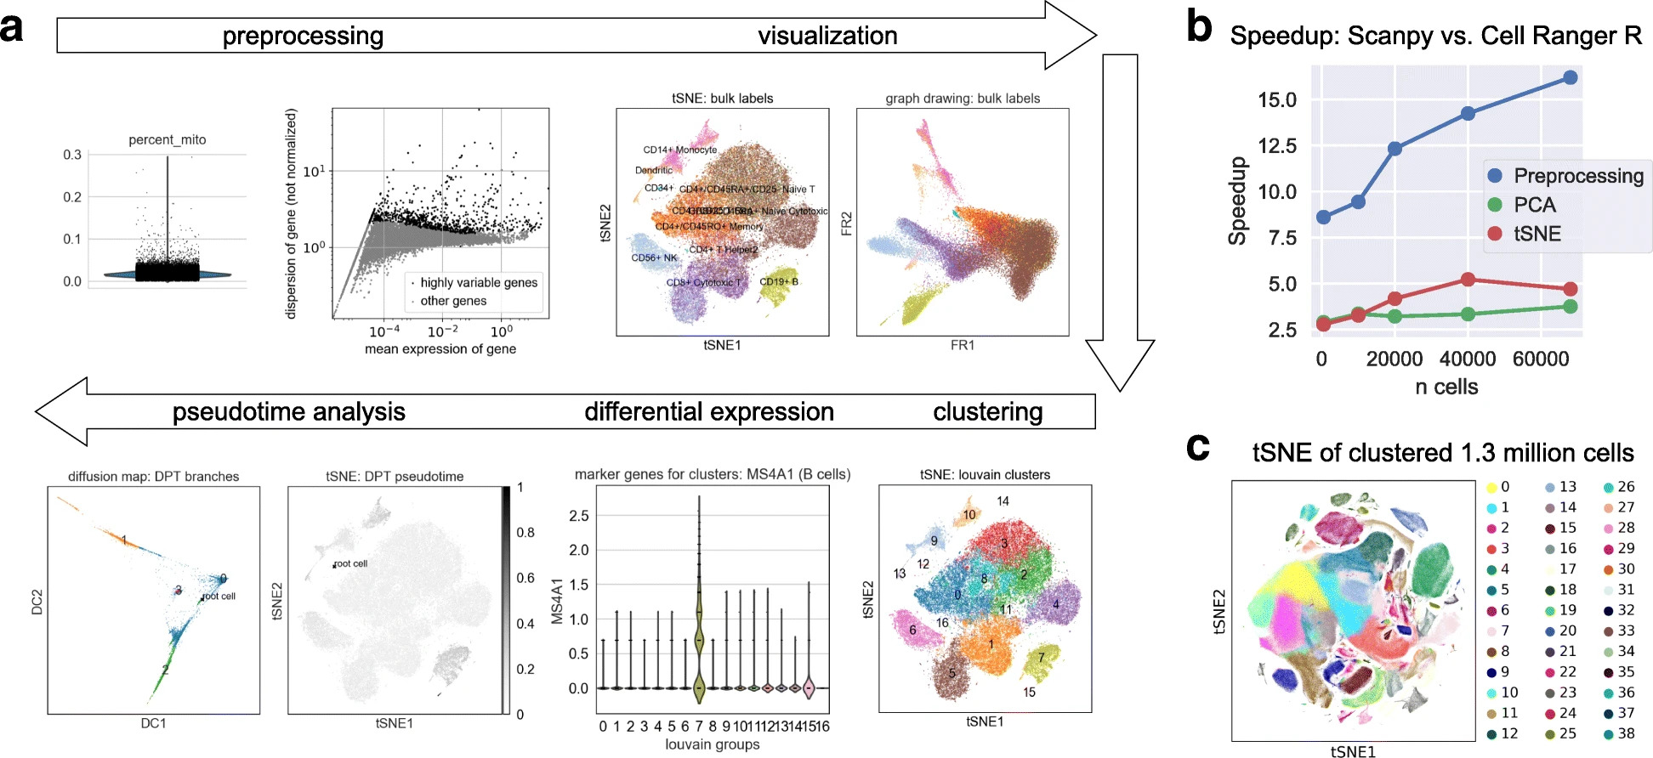
Fig. 4.2 scanpy overview (Book)

Slide 13
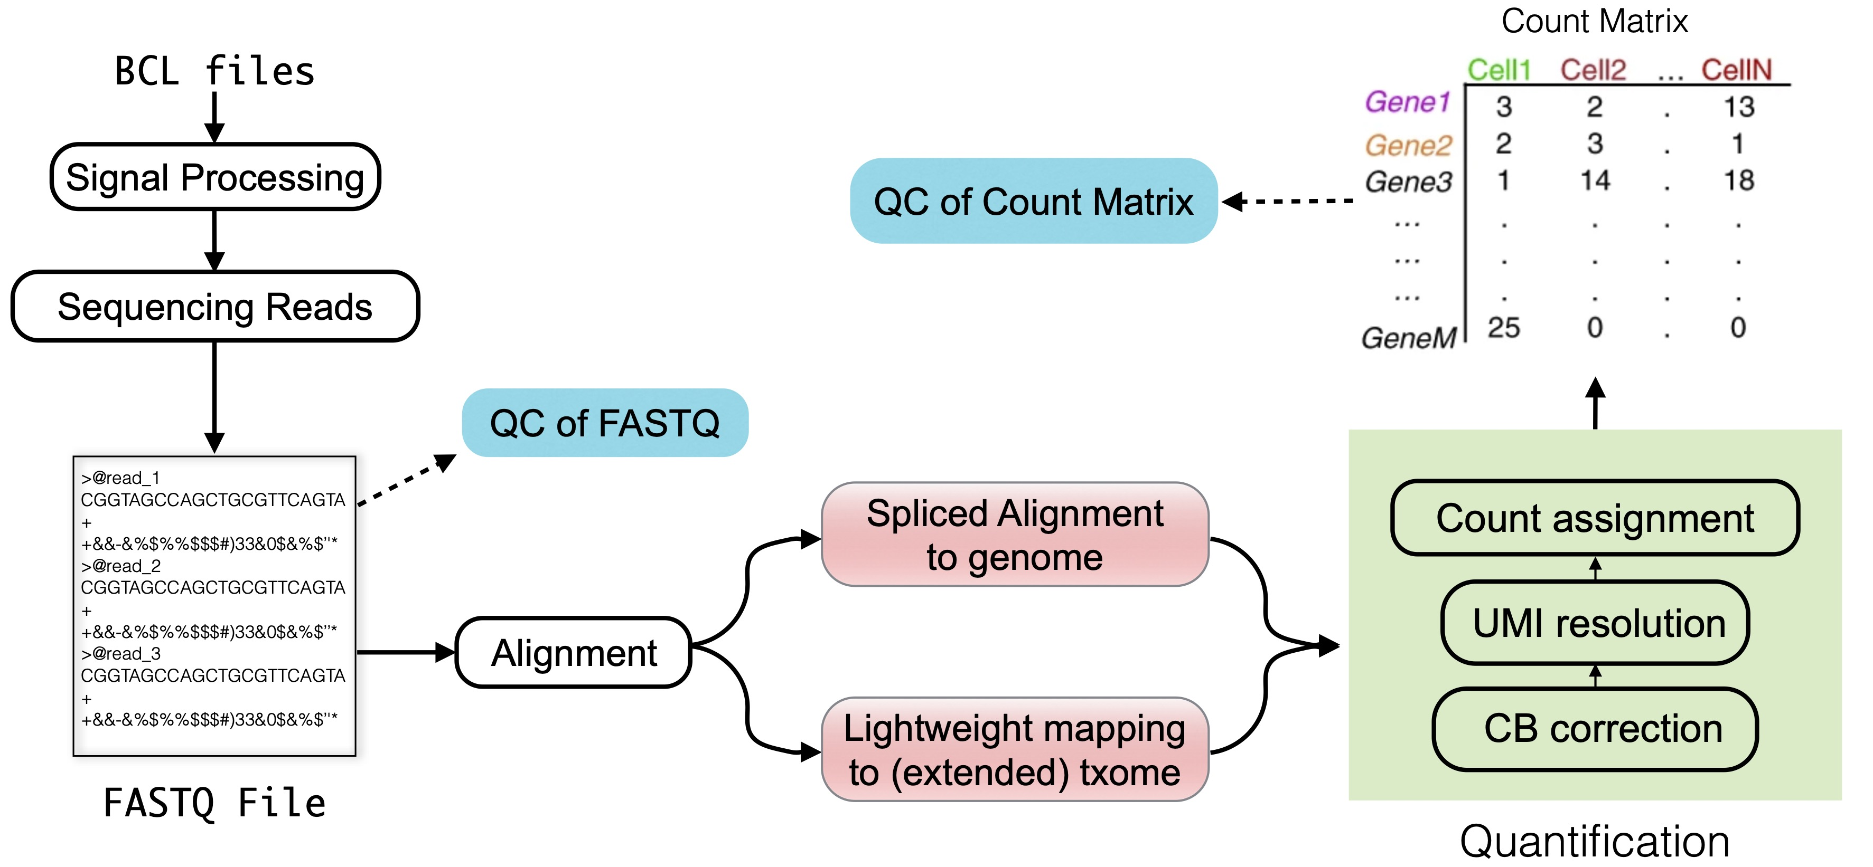
Fig. 3.1 (Book)
“txome” stands for transcriptome

Slide 14
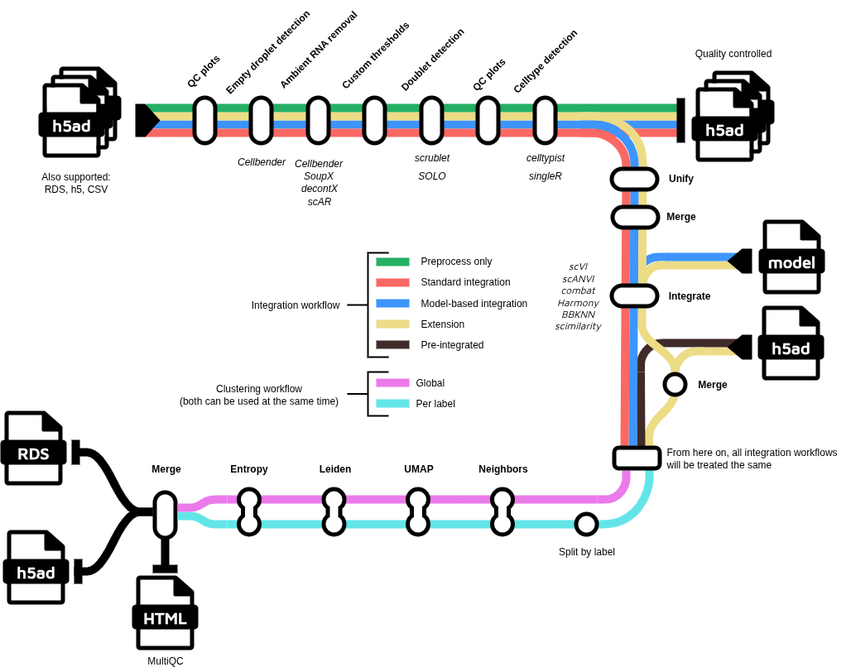
nf-core/scdownstream
https://nf-co.re/scdownstream/dev/

Slide 15
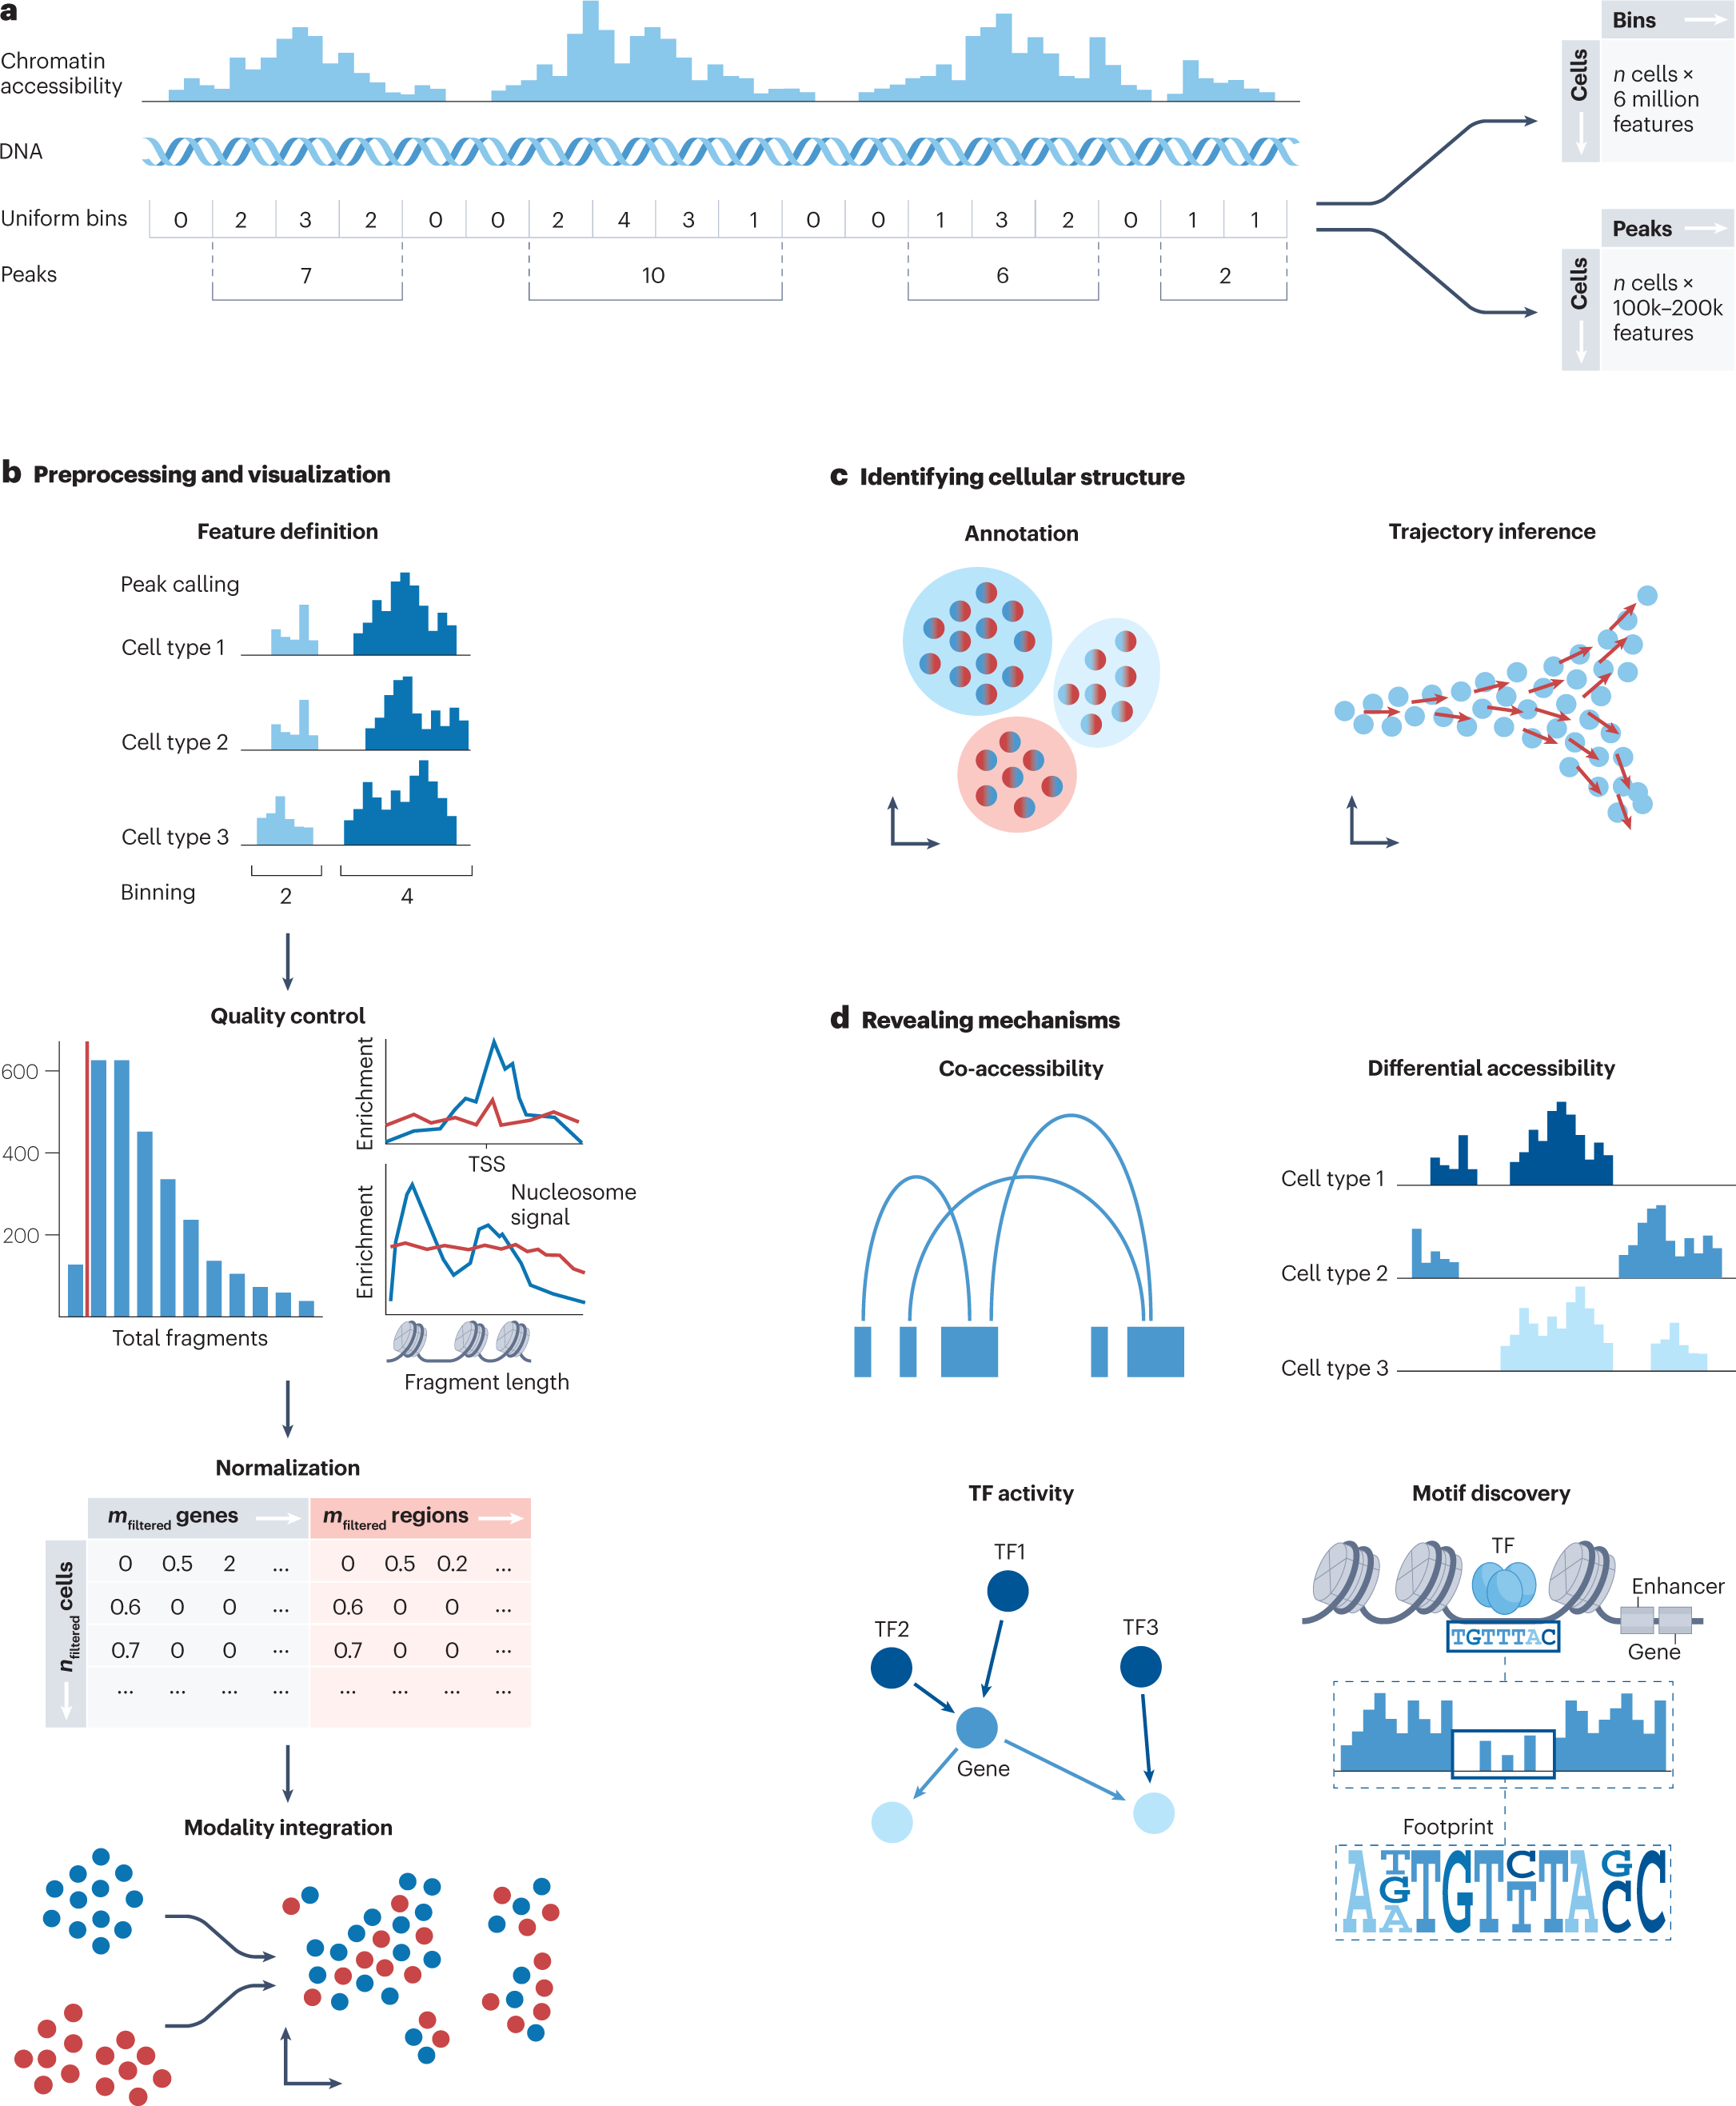
Fig. 3: Overview of scATAC-seq analysis steps

Slide 16
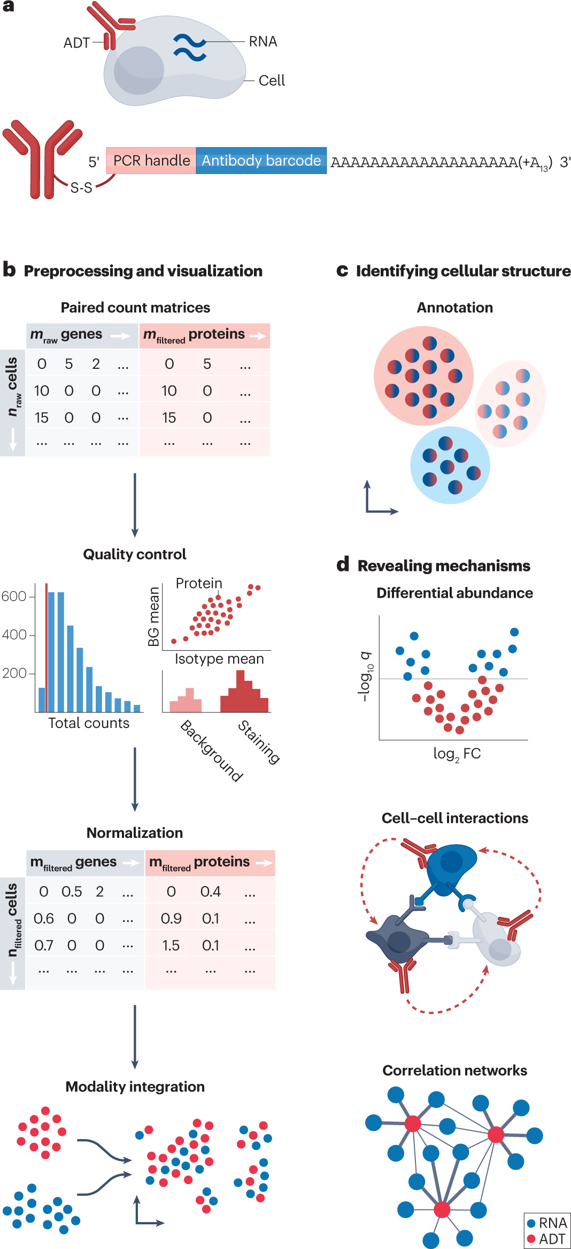
Fig. 4: Overview of CITE-seq data processing

Slide 17
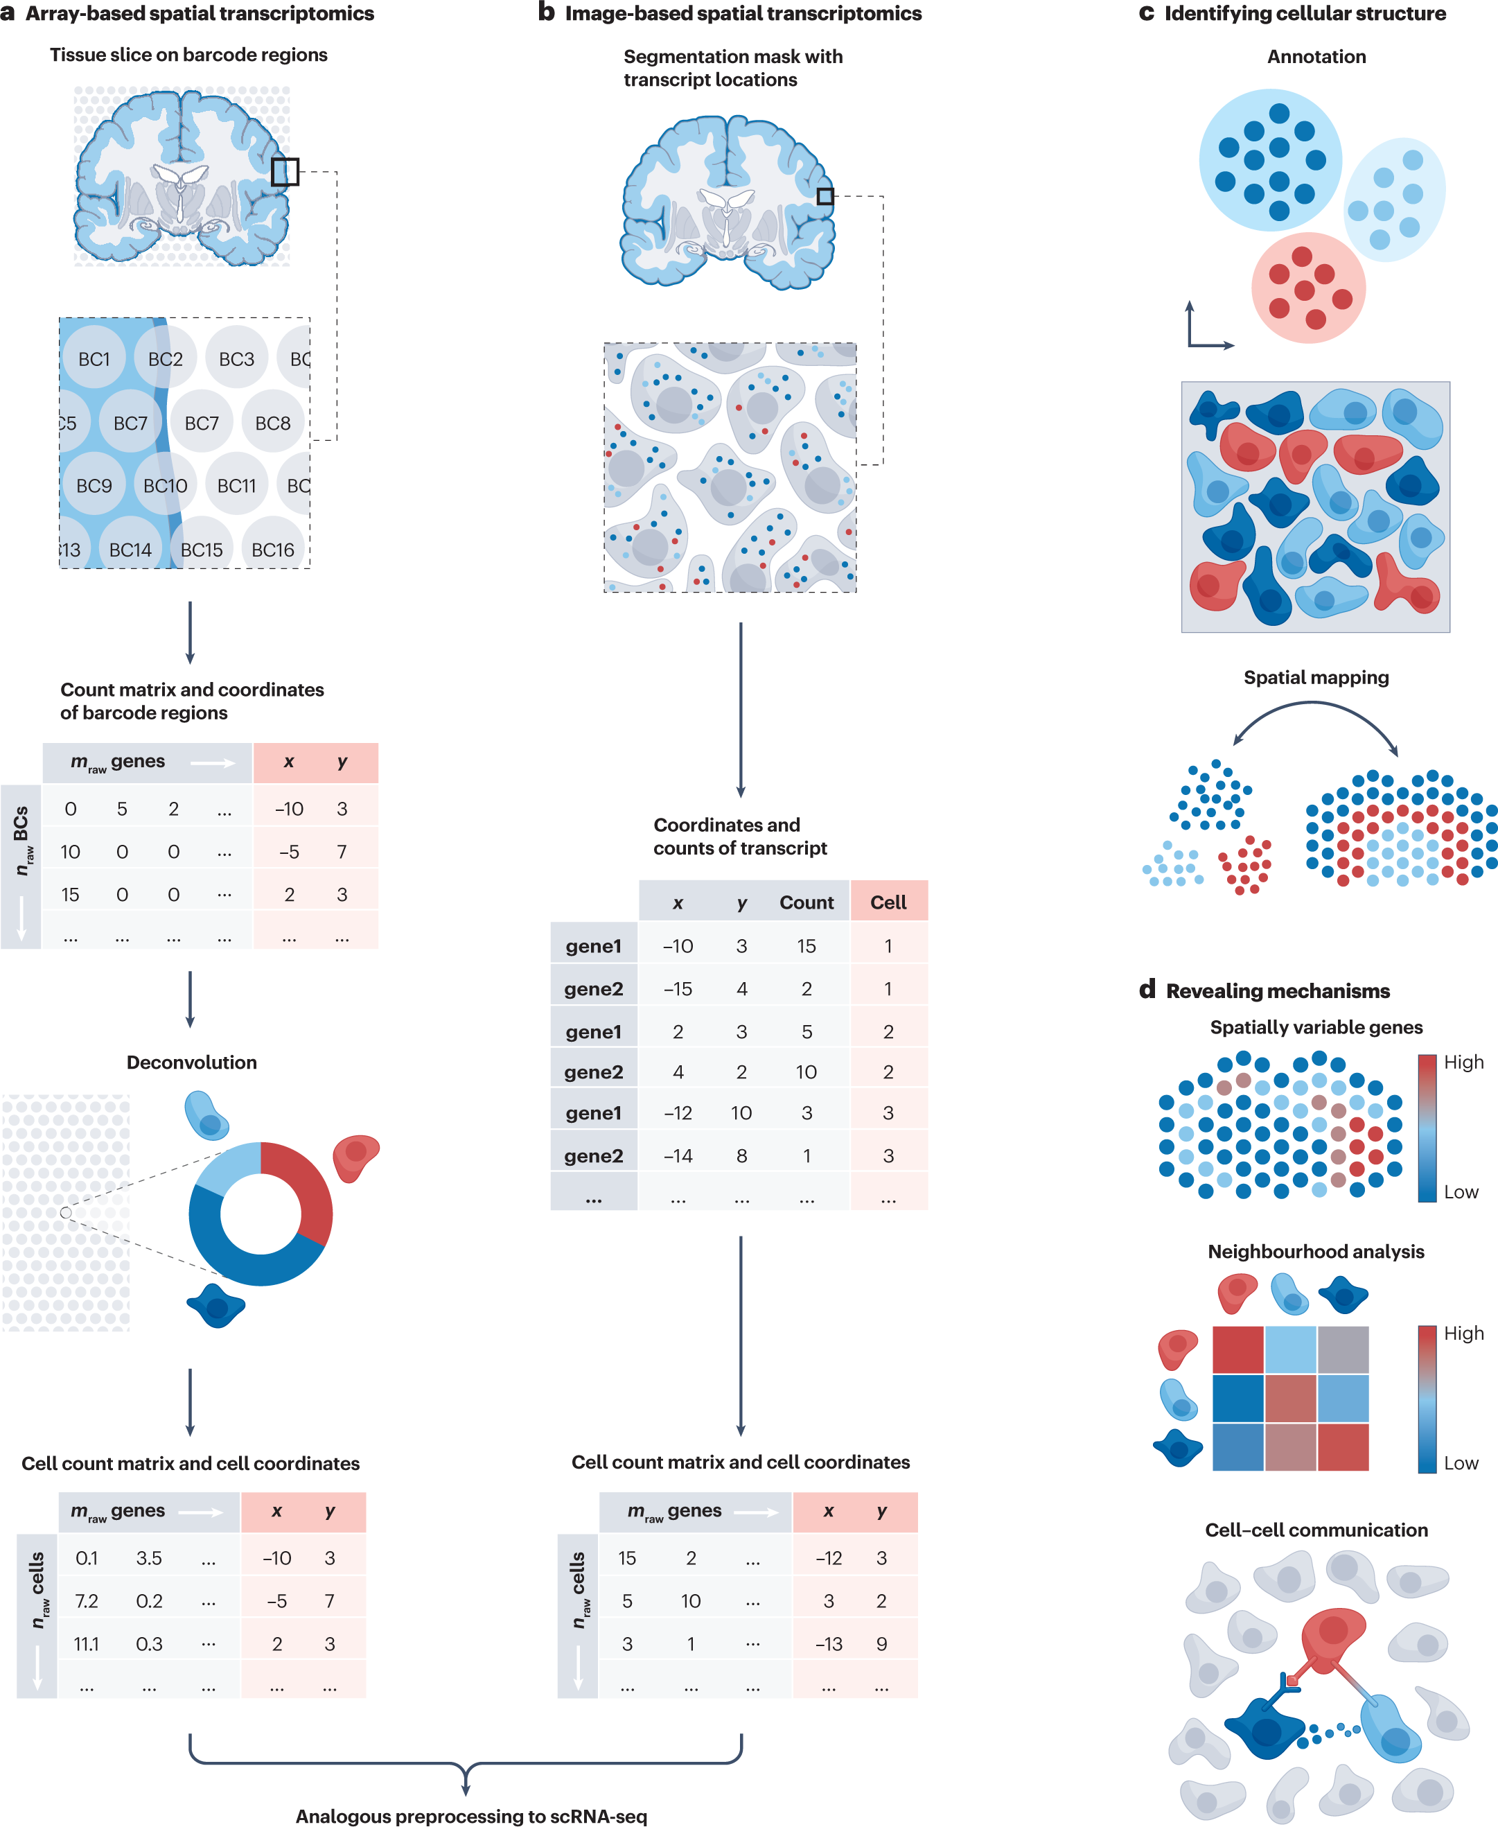
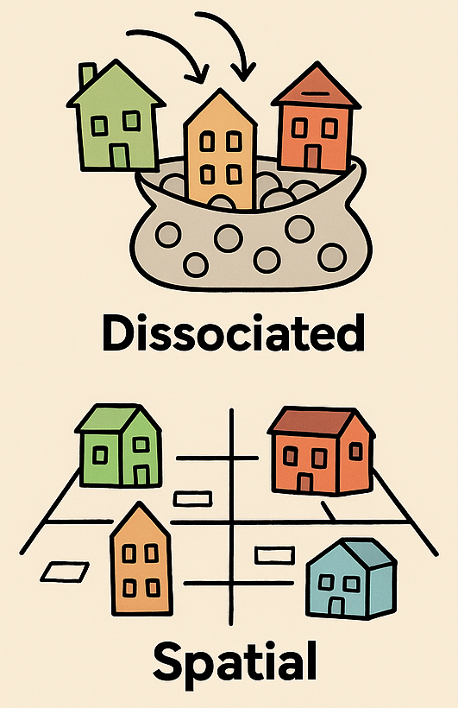
Fig. 6: Overview of spatial transcriptomics preprocessing and downstream analysis steps
Dissociated vs. Spatial Single-Cell

Slide 18

Thank you!

Slide 19
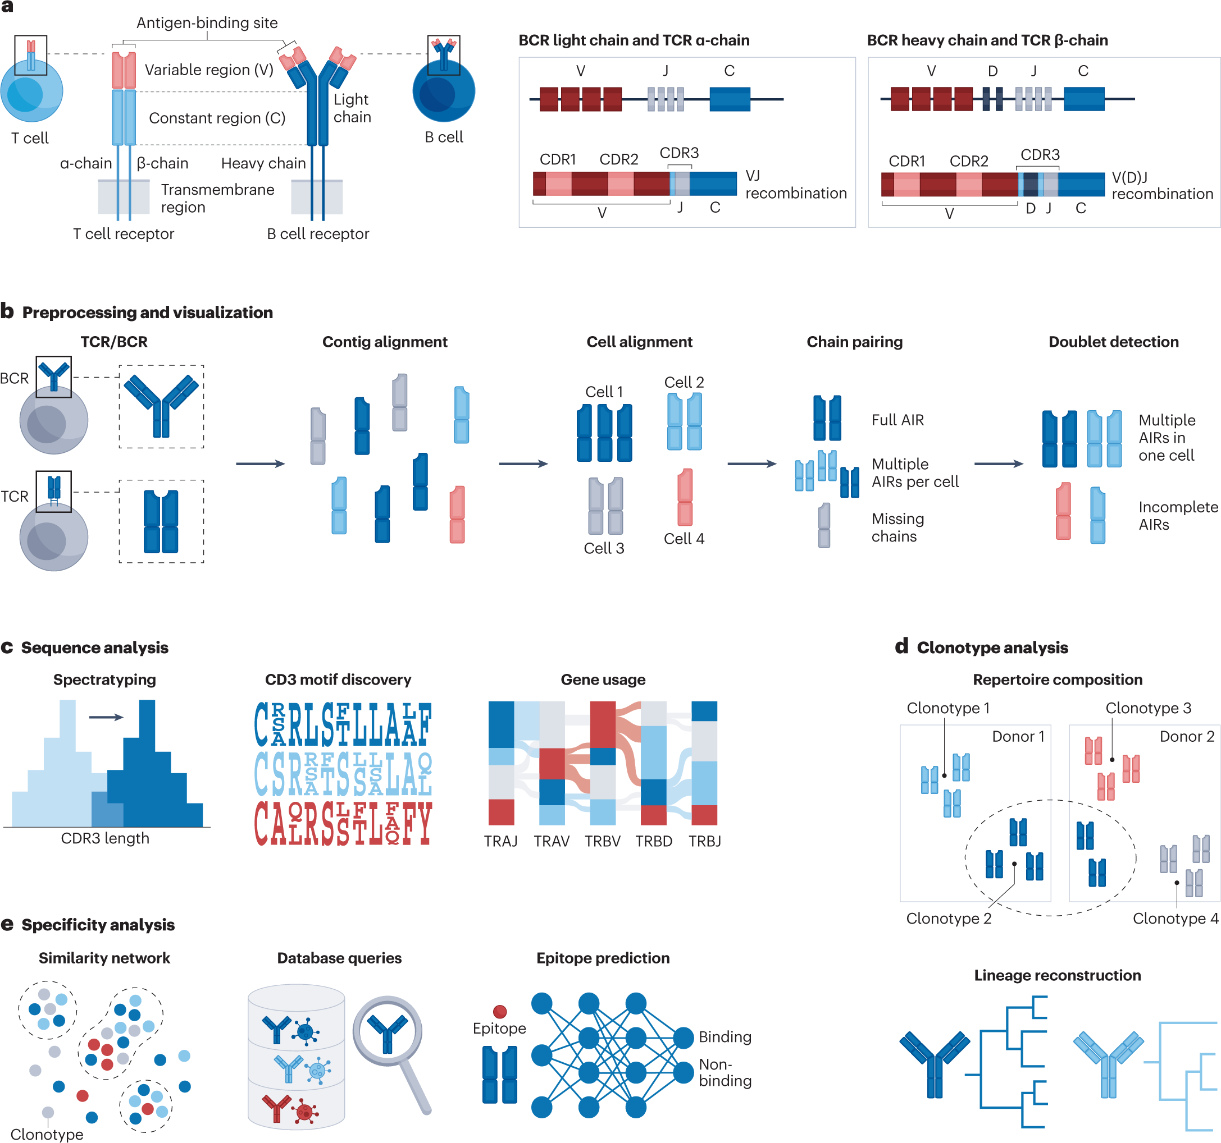
Fig. 5: Overview of the adaptive immune receptor analysis

